Slide 1
A video tutorial on how to use the website for meta-analysis of intrusive memories
https://intrusivememory.shinyapps.io/shinymeta/
Narrator: Dr. Shengzi Zeng 曾盛梓
Developed by Shengzi Zeng, Man Hey Chiu & Jingyun Huang

Slide 2
Outline
An overview of the project & website
How to select data
How to run a main analysis
How to run a moderation analysis
How to run analysis of an individual technique

Slide 3
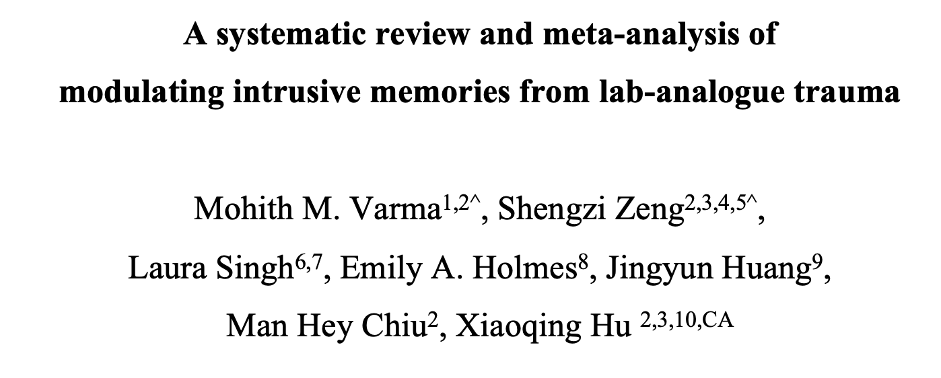
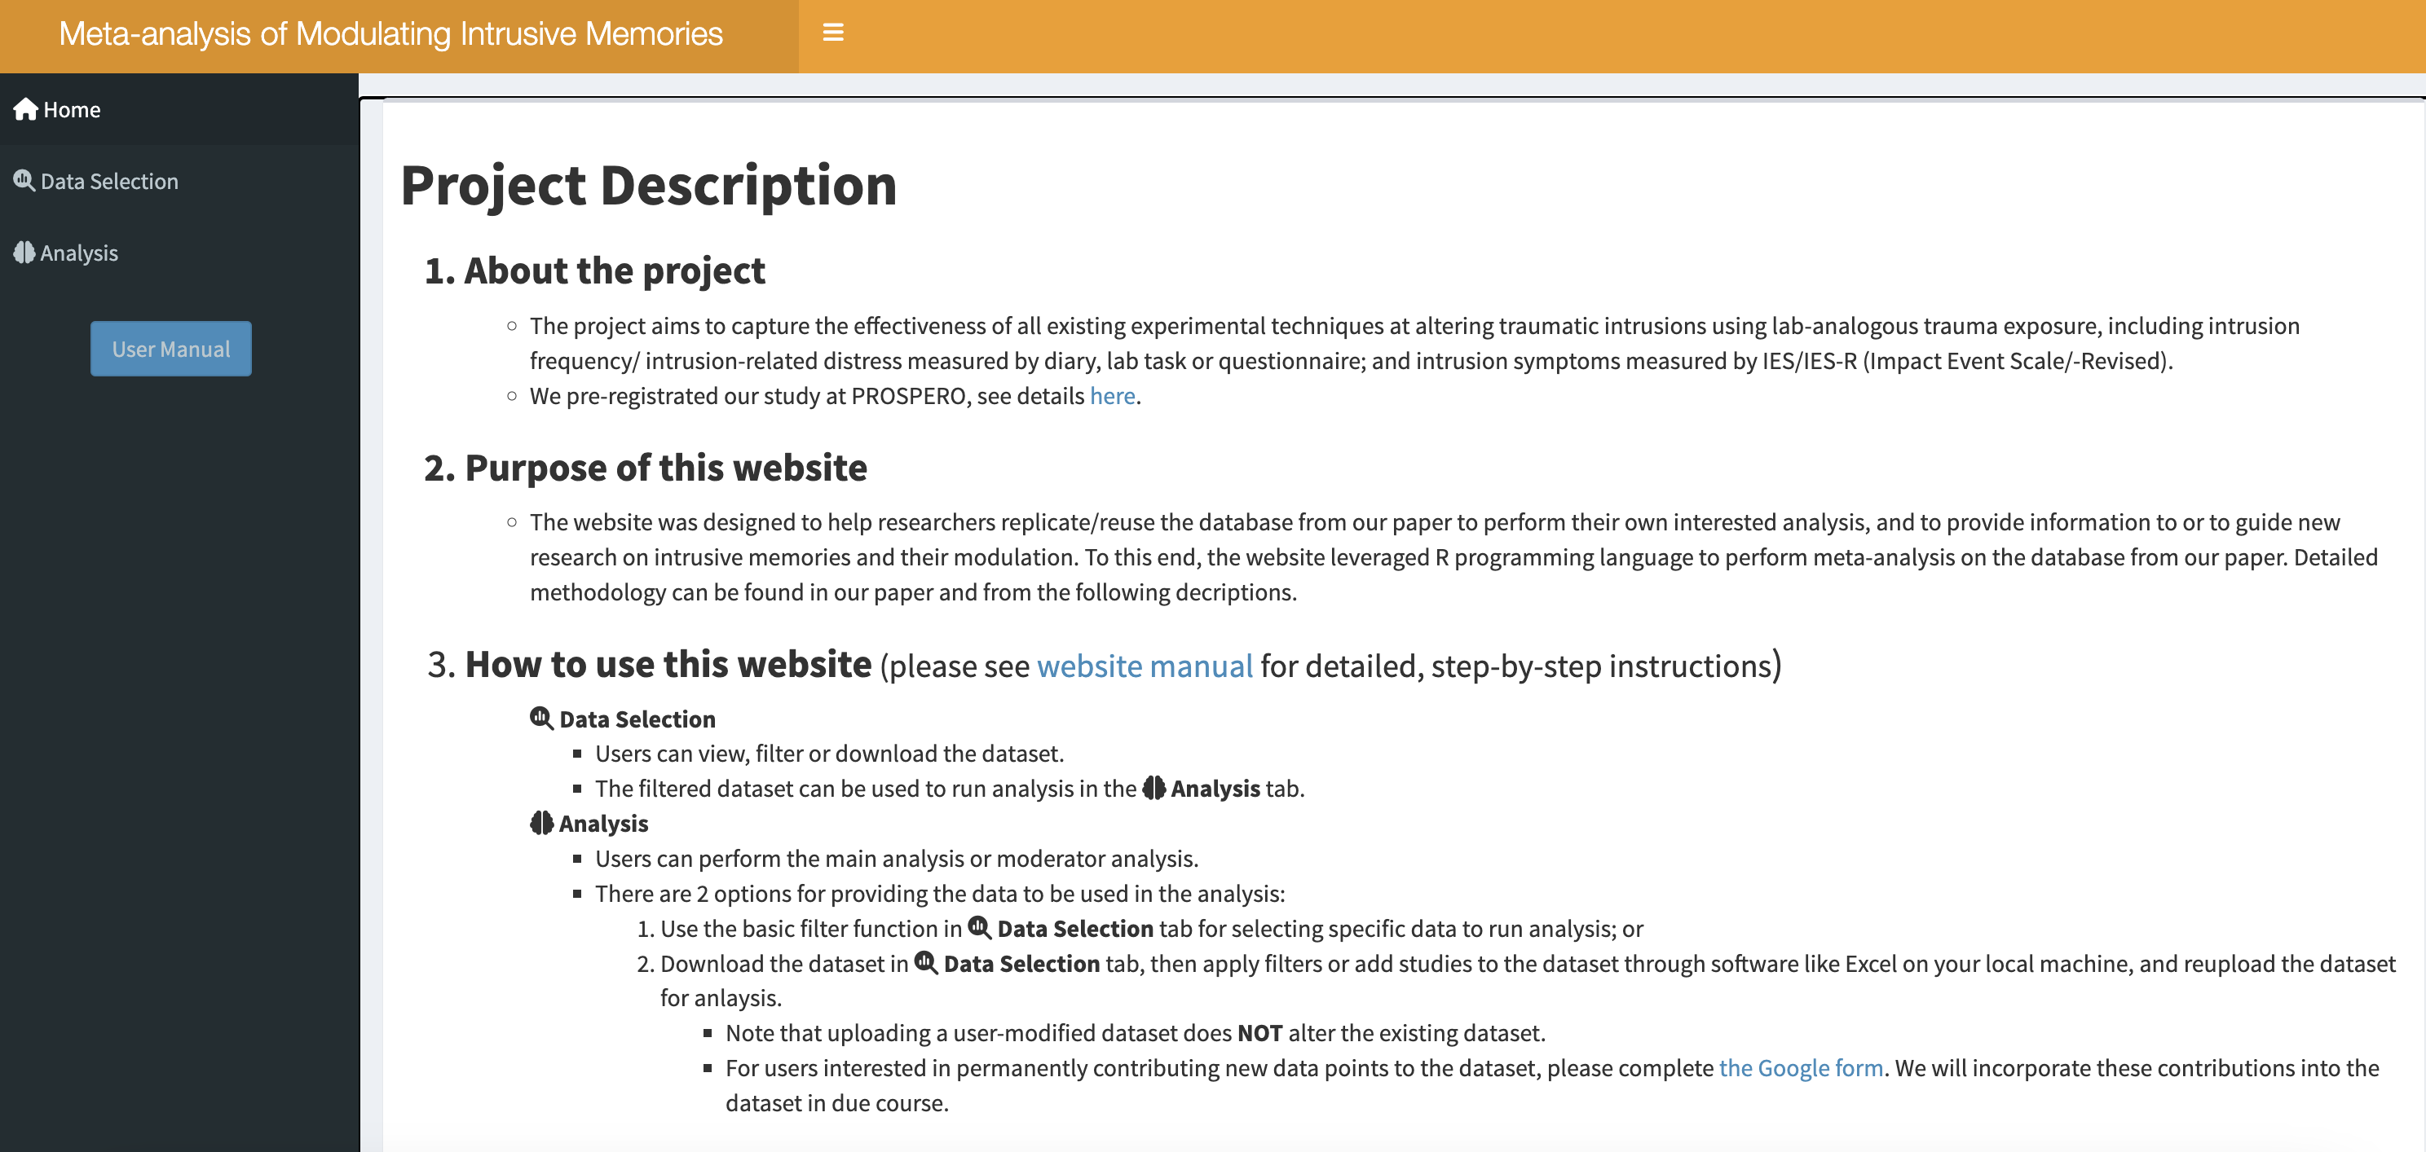
About the project & website
https://intrusivememory.shinyapps.io/shinymeta/
APA Citation:
Varma, M. M., Zeng, S., Singh, L., Holmes, E. A., Huang, J., Chiu, M., & Hu, X. (2023). A systematic review and meta-analysis of modulating intrusive memories from lab-analogue trauma.

Slide 4
Outline
An overview of the project & website
How to select data
How to run a main analysis
How to run a moderation analysis
How to run analysis of an individual technique

Slide 5
Thank you!
If you have any questions, please contact
Man Hey Chiu at mchiu@connect.hku.hk
or
Shengzi Zeng at szeng@bidmc.harvard.edu

